Slide 1
Self-Employed Marketplace
A platform connecting the self-employed buyers with project sellers

Slide 2
About the Platform
A platform connecting the self-employed people (buyers) with project sellers.
The platform will host several projects of 3 types (software, real-estate & aviation)
Any seller can register on the platform and host his/her projects up for bidding
Any buyer can register on the platform and place his/ her bid for the project
The buyer with the lowest bid amount will win the project

Slide 3
Functional Requirements

Slide 4
Scope of Work
MarketPlace
MarketPlace should be able to display the list of all the projects
MarketPlace should be able to display details of any seller active on the platform
MarketPlace should be able to display the details of any buyer active on the project

Slide 5
Scope of Work (cont.)
Seller & Project Bidding
Seller should be able to register on the system
Seller should be able to post the projects with requirements on the platform
The system should be able to pick the lowest bid made for the project
The project should turn inactive (unavailable for further bidding) once the expiry date & time get over
The bid for a project should end as soon the project deadline reaches
Seller should be able to show a project details

Slide 6
Scope of Work (cont.)
Buyer
Buyer should be able to register on the system
Buyer should be able place a bid against an active project
Buyer should be able to win a project if his/her bid turns out to be lowest amongst all the bids made for the particular project
Buyer should be able to mention his/ her work preference (fixed/ hourly wages) while placing the bid

Slide 7
Features Out-of-Scope
User Authentication and authorization not implemented. Anyone is able to access any endpoints of the application
Buyer need not to necessarily meet the project requirements in order to win it (no eligibility checks)
Seller management module not to be implemented
Buyer management module not to be implemented
Seller is not be able to explicitly end the bid once it is up, it can end only when the deadline is over

Slide 8
Assumptions
MarketPlace should display projects of any status ‘Active/ Inactive/ Expired’ in any paginated form
There will be only 3 static types of projects that the platform will host the projects for
A buyer can bid for a project only once
In case, there are multiple lowest bids with same amount, the date & time of bid should be considered (first-come-first-serve) to pick the bid

Slide 9
Assumptions (cont.)
In case, there are more than one lowest bids of same value and even the date & time of bid is same for all, in that case, the bid should be picked randomly
A buyer can not bid once the project is expired
The assessment of lowest bid among the bids of ‘Hourly’ & ‘Fixed’ type will be based on the project duration in no. of hours.
Bid of Fixed type ≡ Bid of Hourly type * Project duration in hours

Slide 10
Non-Functional Requirements

Slide 11
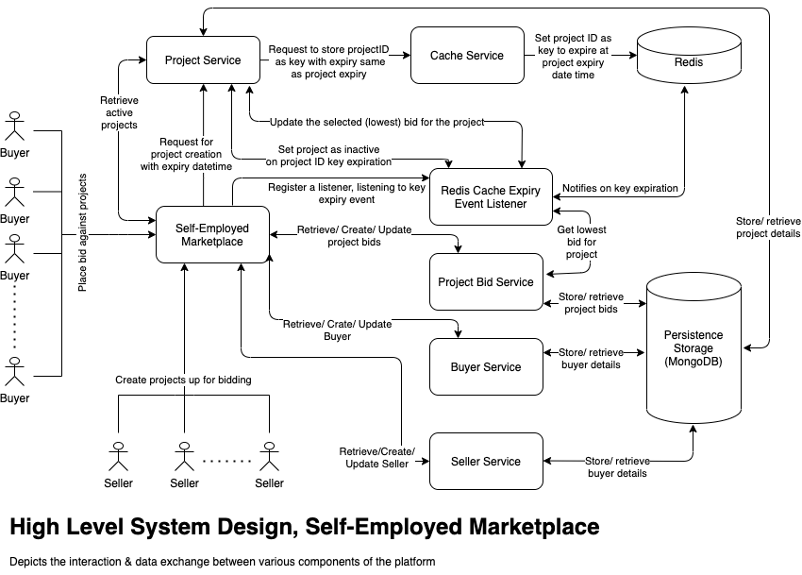
High Level System Design

Slide 12
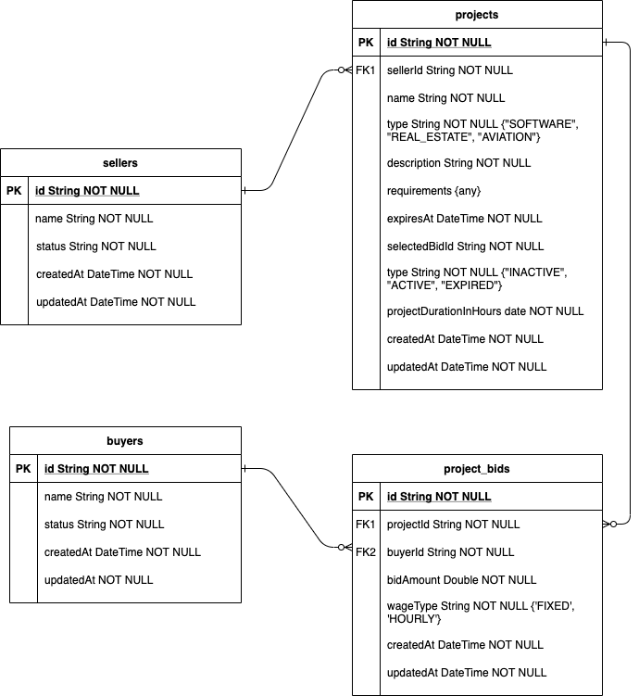
Entity-Relationship

Slide 13
Tech Stack
Java 8
Spring Boot
Mongo 3.6
Spring Data Mongo (MongoTemplate)
Spring Data Redis (RedisTemplate)
Log4J
JUnit
Mockito

Slide 14
Limitations & Enhancements
Limitation
Currently, project expiration depends on the key expiration in Redis which may get disrupted in case the Redis crashes
No authorization or authentication implemented

Slide 15
Limitations & Enhancements (cont.)
Enhancements
Project bidding would take place when the buyer matches the project requirement criteria (s)
Implementation of Authentication & Authorization
Buyer & Seller Management module
Enable the seller to modify the project expiry even when the project have gone live
Expand hosting the project of different other type as well

Slide 16
---

